Slide 1
BFX-UA300 (K18X001.00) RMA
LED Not Working Report
Prepared by: Pham Huy Thuc
Approved by: Michael
Date: Aug 13th 2022

Slide 2
D1. Establish the Team
Team Leader
Team Member
PE: Michael, Thuc
ME: Cheng Lun, Wen Thai
PM: Ben Zheng, An Tran
PD: Ruan Wen Yong
QA: Ken, Rachel
TE: Mark Wu, Allan Pham
IE: Hai Ly, Heng Ruan
Foxconn
  MFG Director: David Yin
  QA Manager : CB Lin, Toney

Slide 3

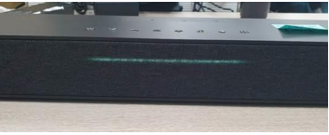
D2. Description
1. Issue Description
- On 30/06/2022, ALT customer complaint 1pcs has LED not working at Customer SW.
- Failure status: Power LED indicator no light when plugging power supply.
Failure information:
NO# | FXC_SN | Cus_SN | MAC | Symptom | Production Date
1 | YWR0IKB | 2149695001202201006480 | A8934AFEBBD5 | Power LED indicator no light | 04/12/2022
OK sample
NG sample

Slide 4
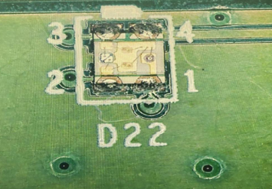
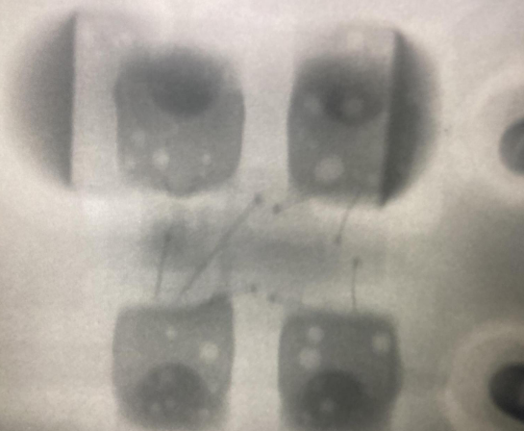
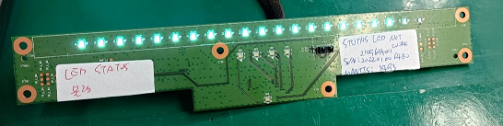
D3: Containment
1. Take X-ray and VI PCBA both Top & Bot side of NG sample LED no light
Visual Inspection → Both top & bot side of defect unit are normal.
Take X-ray D22 location→ Did not find out abnormal.
In front of LED board
D22 – Power LED indication
X-ray D22 location

Slide 5
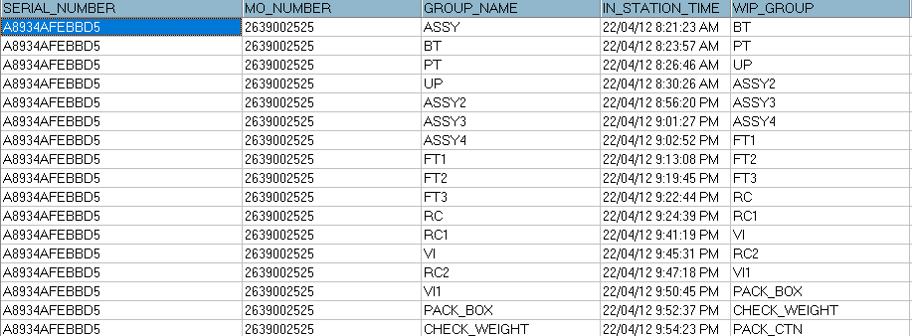
D3. Containment
2. Check FATP data record
Check FATP data record: NG product tested pass at FATP
Summary: NG product didn’t have abnormal on FATP.

Slide 6
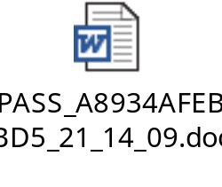

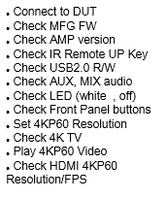
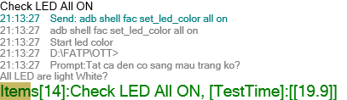
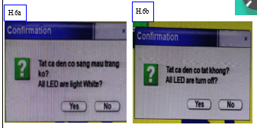
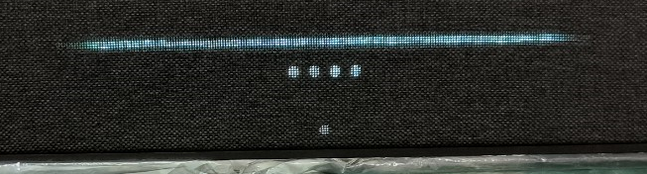
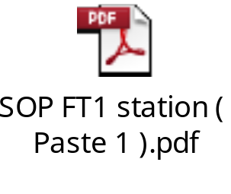
D4. Root Cause
1. Check SOP define and log test at FATP
Check LED light follow SOP define is normal.
Check log test is normal
OP check LED light follow SOP and test program define, then OP confirm follow the result see it.
...
FT1
...
Test plan FT1 station
All LED On Pass at FT1
Summary: LED function tested pass at FT1 station. OP check LED light follow SOP and test FT1 program define.
Result pass normal.

Slide 7
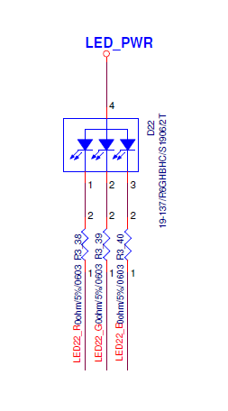
D4. Root Cause
2. Measure Impedance and Voltage of D22 location.
Measure impedance of D22 location ➔ No abnormality
Measure voltage of D22 location ➔ Have abnormality as table below:
Location | Impedance (Ω) |  | Voltage (V)
 | NG sample | Ok sample | NG sample | Ok sample
LED_Red | 3.32M | 3.3M | 0V | 3.17V
LED_Green | 3.3M | 3.31M | 0V | 2.31V
LED_Blue | 3.31M | 3.3M | 0V | 2.23V
LED_PWR | 5.4M | 5.52M | 4.99V | 4.99V
LED Schematic
Summary: Check power supply of D22 found out the output voltage abnormal at Pin1 (LED_Red), Pin2 (LED_Green), Pin 3 ( LED_Blue) .

Slide 8
D4. Root Cause
3. Swap verification LED.
Swap verification between D22 NG sample and D22 OK sample, result as table below:
Test Time Power LED Swap | 1 | 2 | 3 | 4 | 5
OK board + OK D22 | OK | OK | OK | OK | OK
NG board + NG D22 | NG | NG | NG | NG | NG
OK board + NG D22 | NG | NG | NG | NG | NG
NG broad + OK D22 | OK | OK | OK | OK | OK
Summary:
- Swap D22 OK into NG board and retest 5 times ➔ Result Pass 5/5 times.
- As analysis above this issue follow D22 ( P/N:123.00701.005 ) component.

Slide 9
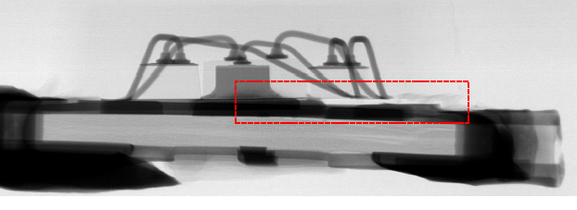
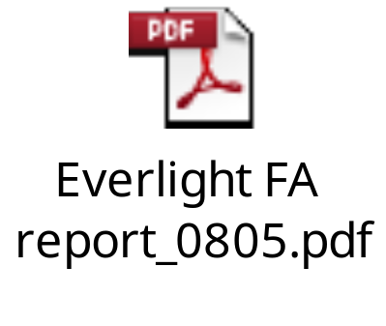

D4. Root Cause
4. Conclusion Root cause.
As analysis above this issue follow D22 ( P/N: 123.00701.005 ) component.
See FAR of D22_NG LED in attachment file below.
Root cause D22 no light : X-ray D22: The gold wire of crack position is broken. “ R G B color light presentation OPEN no light ”.

Slide 10
Conclusion
Summary for root cause
Root cause:
This issue happen when product Power LED indicator no light when plugging power supply.
As an analysis above D22 ( P/N:123.00701.005 ) component issue “ R G B color light presentation OPEN no light ”.
Root cause Occurrence :
1. May cause from vendor LED incoming material ( Auto test and tapping station ).
2. And may cause Fii On line process from SMT to FATP can make D22 crack/ brocken.
Root cause Escape:
1. That time ( 12-Apr ), production line did not check LED by the auto testing program.
2. OP check LED by visual inspection at FT1 station may be he did not check carefully and passed to next test
station.

Slide 11
Conclusion
Corrective action
Action from LED vendor:
Request Everlight vendor provide corrective action for 2 risk station : Auto EL test and Tapping .
Due date: 2022/08/20

Slide 12
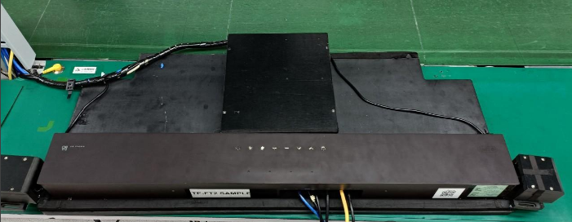
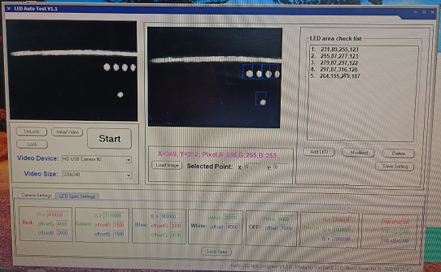
Conclusion
Corrective action
Action from Fii production line:
- Apply auto check LED at FT1 station for test all LED light function . Done: 2022/04/23
- Fii will keep monitoring this issue on FATP.
FT1 test Fixture auto check all LED

